Slide 1
Resume Checker
AI-Powered Resume Analysis System
Django • spaCy • NLTK • NLP
Team Members: Basabee Hati
2403A54131

Slide 2
Project Objectives
🎯
Automate Resume Analysis
📊
Multi-Dimensional Scoring
Build an intelligent system that automatically evaluates resumes using advanced NLP techniques, eliminating manual review overhead.
Provide comprehensive scoring across 4 key dimensions: keyword matching, readability, ATS compatibility, and skills gap analysis.
💡
Actionable Insights
🌐
Modern Web Interface
Generate specific, actionable recommendations to help candidates improve their resumes and increase interview chances.
Deliver results through a polished Django web application with intuitive upload, real-time processing, and visual dashboards.

Slide 3
Key Stakeholders
👤
Job Seekers
💼
Recruiters
Primary users seeking resume improvement
Use insights to streamline candidate screening
ResumeIQ
Platform
🎓
Career Counselors
🏢
HR Departments
Leverage tool for student/client guidance
Integrate system for applicant pre-qualification

Slide 4
Technologies & Tools
Backend & Framework
NLP & Processing
• Python 3.10+
• spaCy 3.7 (en_core_web_sm)
• Flask
• NLTK 3.8
• MySQL DB
Frontend
• HTML5 & CSS3
• JavaScript
• Responsive design

Slide 5
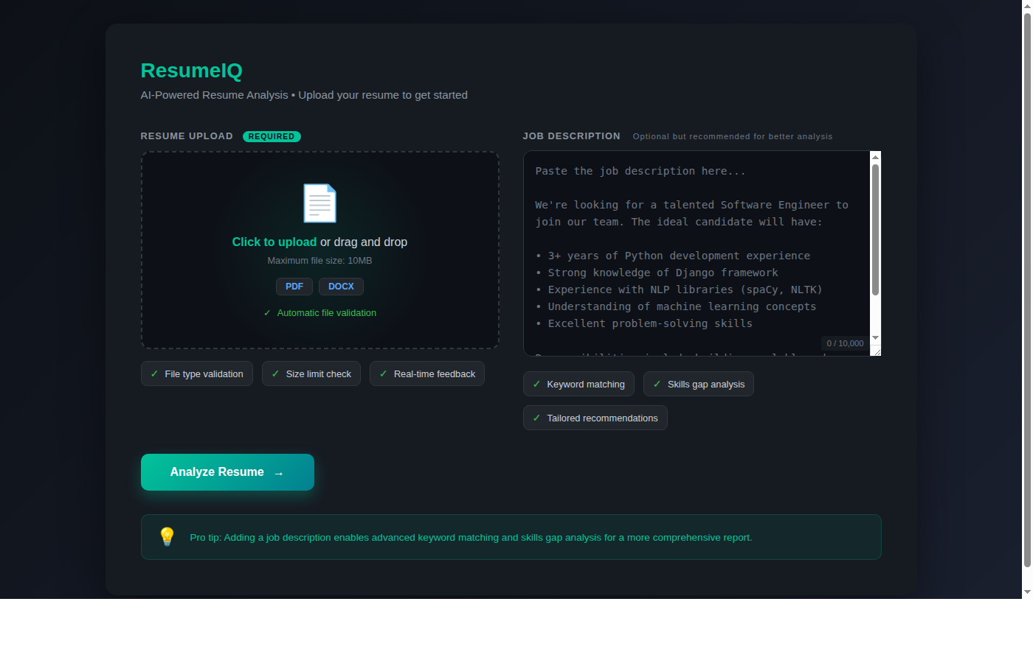
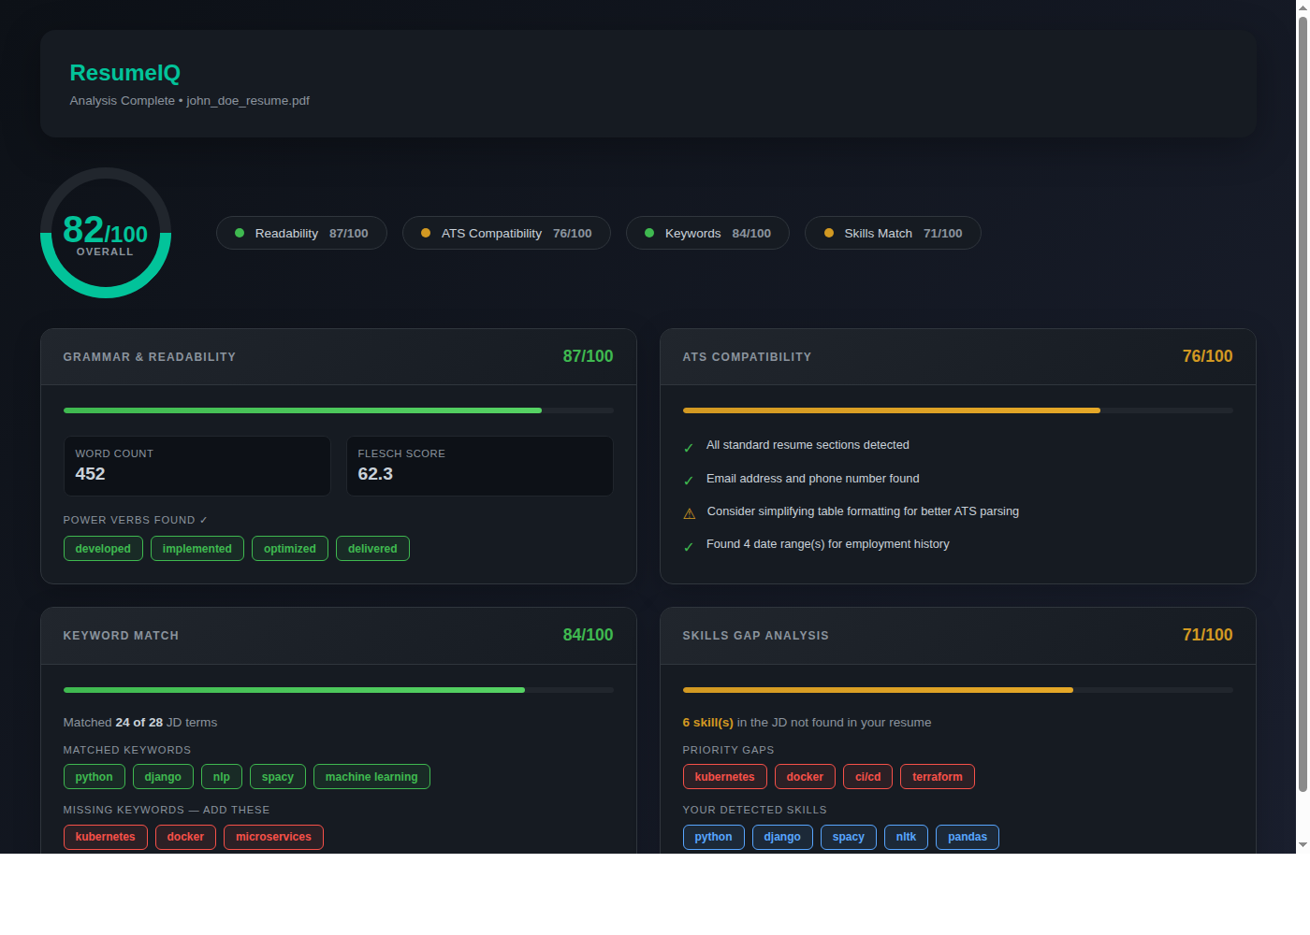
Application Interface
Upload Page
Drag-and-drop interface for PDF/DOCX resume upload with optional job description input
Key Features:
✓ File validation
✓ JD textarea
✓ Responsive form
Analysis Dashboard
Comprehensive results with animated score rings, progress bars, and categorized insights
Key Features:
✓ 4 analysis modules
✓ Visual scorecards
✓ Actionable tips

